Slide 1
Case Study – Lending Club
Objective:
A Presentation on-
1. Informing the EDA analysis made as part of case study and
2. Stating a set of Driving Factors for possibility of Loan Defaulting.
Thus minimise the risk of losing money while lending to customers.
Authors:
1. Abhishek Tyagi
2. Praveen Padmanabhuni

Slide 2
Data Cleaning
Columns:
1. Remove all the columns after 50(AX)
All columns after column 50 are empty or have single value. So, we decided to remove all these columns
2. Remove few of the Customer Behaviour Variables
Few of these variables cannot be available at time of loan application.
Rows:
1. Remove rows that are empty
Removed rows that are empty across multiple columns
2. Remove rows of applicants not useful for analysis
Removed rows of applicants whose loan status is Current

Slide 3
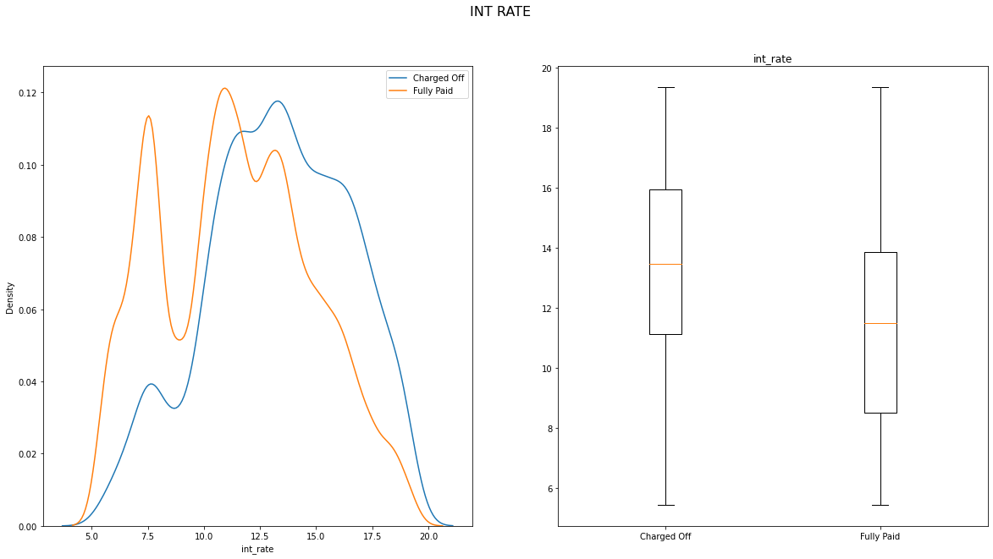
Driving Factor : Interest Rate (int_rate) EDA Type: Univariate Analysis Graph Type: Density Plot, Box Plot Analysis: As the graphs inform, 1. In Density plot, beyond a certain interest rate there is a clear shift for Charged Off 2. In Box plot, the 25%,Median and 75% are clearly at high interest rates for Charged Off.

Slide 4
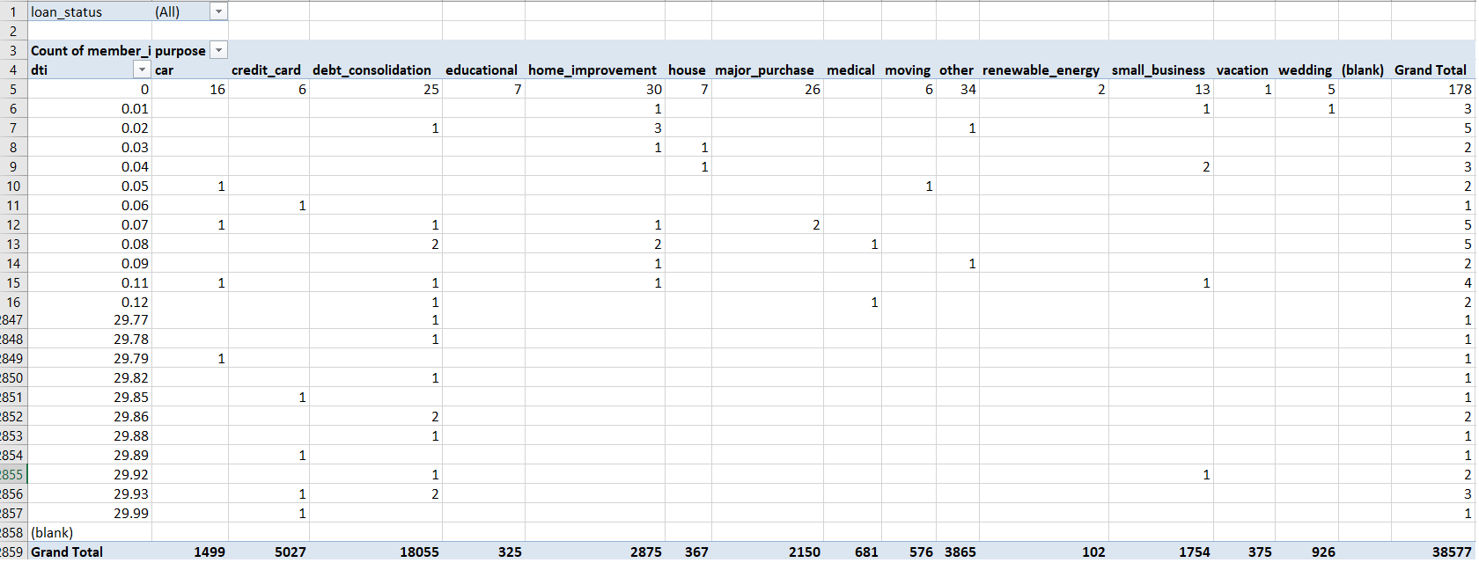
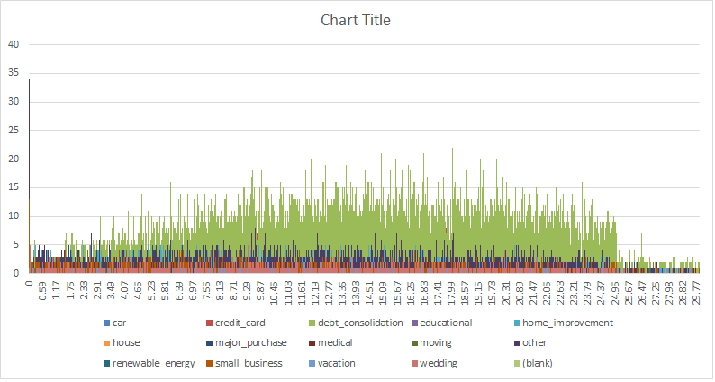
Driving Factor : Purpose EDA Type: Multivariate Analysis Graph Type: Pivot Table, Bar chart Analysis: 1. From Pivot table, Applicants for purpose of Small Business has high chance for Loan defaulting. For purpose as "small business" default percentage: is 27.08% and is highest amongst other factors

Slide 5
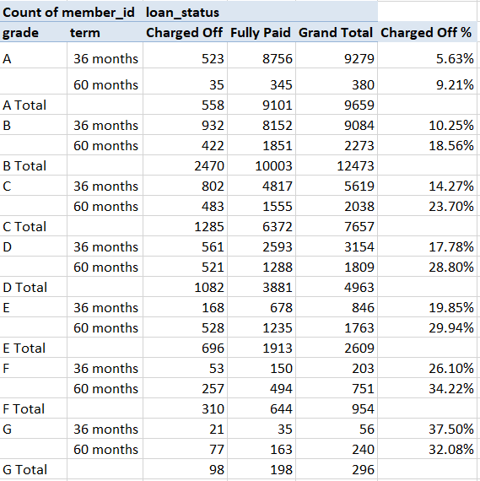
Driving Factor : Grade EDA Type: Multivariate Analysis (Grade-Term-Loan status) Graph Type: Pivot Table Analysis: From the pivot table as the grade going forward i.e. A-> G, the percentage of charged off applicants across both 36, 60 months terms is high.

Slide 6
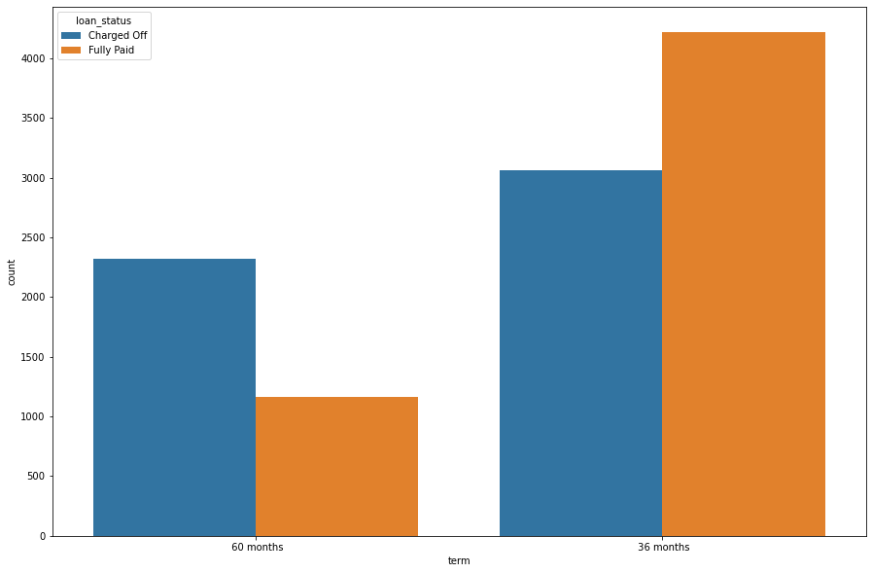
Driving Factor : Term EDA Type: Bivariate Analysis (Applicant Count-Loan status) Graph Type: Bar Chart - Count Plot of sampled data with samples equal to the number of total defaults Analysis: From the Count plot, it can be clearly observed that applicants with higher chance of defaulting when term is 60 months.

Slide 7
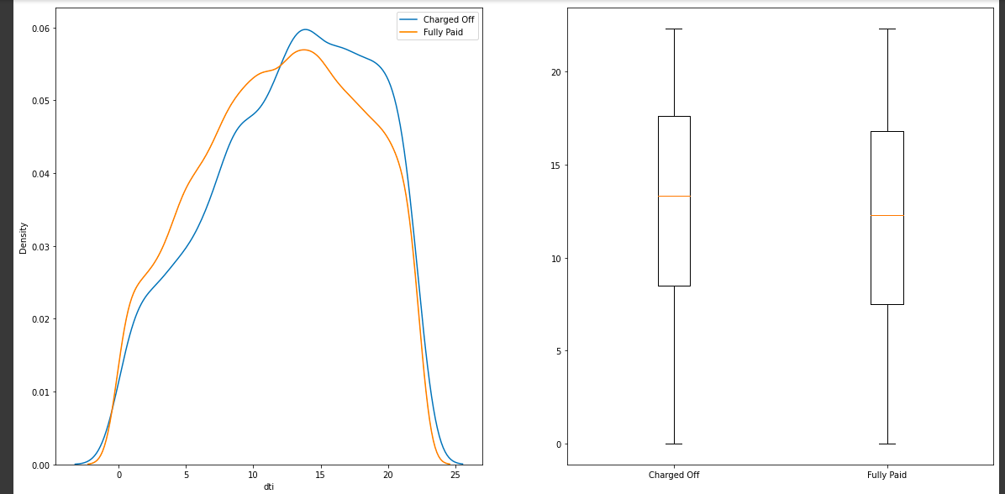
Driving Factor : DTI (Debt to income ratio) EDA Type: Bivariate Analysis (DTI-Loan status) Graph Type: Bar Chart - Density Plot, Box Plot Analysis: In both the plots we can see a shift in charged off data towards higher dti value. Which indicates a higher risk of default as dti increases

Slide 8
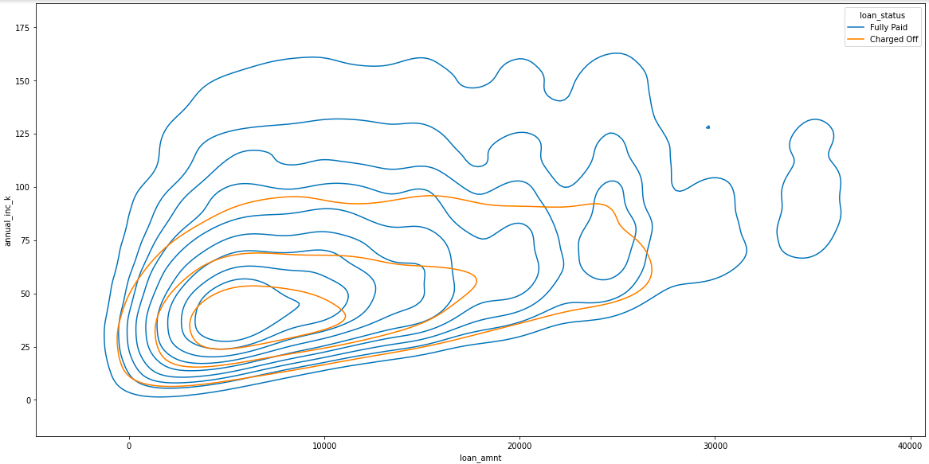
Driving Factor:
Annual Income and Loan amount EDA Type: Multivariate Analysis (DTI-Loan status) Graph Type: Contour Plot: Loan Amount, Annual Income in thousands and Loan Status Analysis: 1. Tendency to default is vary low above 90,000
2. Tendency to default is low when loan amount is larger than 28,000

Slide 9
Conclusions
A lower annual income suggests higher chance of default.
Higher DTI (debt to income ratio) suggests higher chance of default.
There is an increased chance of default when purpose is small_business
Higher loan amount results in higher chance of default, except when purpose is moving, house or renewable energy
Above annual income of about 90,000 there is a high chance that the loan will be paid off.
There is a good chance of loan repayment when the loan amount is higher than 28000.
When purpose of loan is 'moving', sost number of defaults happen when loan is disbursed between May and September

Slide 10
Thank You
Driving Factors:
1. Interest rate
2. Purpose
3. Grade
4. Term
5. DTI (Debt to income ratio)
11-05-2022
IIIT-B - UpGrad

